Slide 1
Rover.com
Online Matchmaking for Pet Owners and Sitters － A Sharing Economy Startup
Notes:
Group members:
Ma Chun Yiu 1155082998
Yu Sharon Cheuk Lam 1155064221
Chan Lok Hang 1155062722
Lam Cheuk Fung 1155063063
Lau Yuk To 1155047823
Sing Cheuk Yan 1155064359

Slide 2

Our Agenda
01
Company Background
What we will cover… In the next 20 minutes
02
Business Model Rover Operating in a Two-sided Market
03
Business Environment How Rover Create Value for its Customers
04
Challenges in Sharing Economy Challenges Rover face as a Sharing Economy Startup in terms of Quality Assurance & Trust Issues
05
Recommendations
06
Appendix & References
Notes:
With the increasing popularity of Sharing economies, especially for markets such as the United States, Rover.com is a great example to earn an insight to what has been done right, and their potential weaknesses.
The following presentation will cover Rover.com’s business and it’s position in the market using Porter’s five forces and the SCP model. Also investigating into how Rover.com managed to deal with common pitfalls on online sharing economy platforms and some preliminary recommendations for their next step.

Slide 3




Facts & Figures “Millions of services booked. Thousands of wagging tails.”
140,000+ Sitters from 10,000+ Cities across U.S. and Canada; 181 Employees
Booking for various services at a rate of one every four seconds
Financial Health Exact revenue/ profit figures were not disclosed to the public
Valued at around USD 866.67 million in July 2017
Generated over $150 million bookings in 2016
Total funding raised: USD 155.9 million
Awards 2014 GeekWire Awards Startup of the Year - Rover.com
2016 GeekWire Awards CEO of the Year- Aaron Easterly
Seattle Business Magazine 2017 Executive Excellence Award- Scott Porad, CTO
Inc.’s 30 Under 30 2017- Philip Kimmey, Co-founder
Notes:
Reference:
Albert-Deitch, Cameron. “This Founder Turned Doggy Daycare Into a $300 Million Business.” Inc.com, Inc., 25 Apr. 2017, www.inc.com/cameron-albert-deitch/30-under-30-2017-rover-com.html.
Funderbeam. 2018, www.funderbeam.com/startups/rover-com/funding?ref=teleport.
Jorgensen, Erica. “Rover.com Wins the 2014 GeekWire Startup of the Year Award!” Rover.com, 30 Sept. 2014, www.rover.com/blog/rover-wins-geekwire-startup-of-the-year-award/.
Truzzi , Gianni. “The 2017 Executive Excellence Awards: Scott Porad.” Seattle Business Magazine, 2 Mar. 2017, seattlebusinessmag.com/profiles/2017-executive-excellence-awards-scott-porad.

Slide 4
History of Rover.com
‘DogVacay’ Acquisition
Acquired Santa Monica CA-based major competitor in an all-stock deal in March; DogVacay becomes a wholly-owned subsidiary of Rover.com
Service Expansion
Expanded its services to all 50 states in U.S & Obtained first round of funding of USD 3.4M in April
2013 -2016
2011
2018 -
“Rover.com” Founded
The concept of “A Place for Rovers” debuted in Seattle Startup Weekend and won Top Prize in the 54-hour coding marathon during which teams compete to build innovative online services
Fundings
Obtained up to 100M fundings in 4 years span*
IPO Preparation
Preparing for its IPO aiming to emerge as a public company in the future
2012
2017
Notes:
* Detailed History of fundings 2011: Founded in December, Rover.com is headquartered at Seattle
2013: Obtained funding of USD 7M in February and USD 3.5M in July
2014: Obtained funding of USD 12M in March
2015: Obtained funding of USD 25M in March
2016: Obtained funding of USD 40M in October
Reference: Cook, John. “An Airbnb for Your Pet? A Place for Rover Wins Best in Show at Startup Weekend.” GeekWire, 27 Mar. 2014, www.geekwire.com/2011/airbnb-pet-introducing-place-rover/.
http://fortune.com/2017/07/13/dog-walker-rover-startup/
Roof, Katie, and Ryan Lawler. “Rover and DogVacay Merge to Dominate the Pet-Sitting Market.” TechCrunch, TechCrunch, 29 Mar. 2017, techcrunch.com/2017/03/29/rover-dogvacay-merge/.
Schlosser, Kurt. “Rover Acquires DogVacay, Its Biggest Competitor in the Online Dog-Sitting Marketplace.” GeekWire, 30 Mar. 2017, www.geekwire.com/2017/rover-acquires-dogvacay-biggest-competitor-online-dog-sitting-marketplace/.

Slide 5






Services Provided “The nation’s largest network of 5‑star pet sitters and dog walkers.”
Dog Boarding
House-sitting
Dog-walking
Drop-in Visits
Doggy Day Care
Rover store
Overnight pet care when owners are out of town
Pet sitter also takes care of the house
Half an hour based dog walking service for an average price of $19
Alternative to full-time sitter providing personalized pet care
One-time visit or regular appointments with favourite pet sitter
Online shop selling pet supplies, clothes, accessories
Notes:
Extracted from: “Book Dog Boarding, Dog Walking & More.” Rover.com, 2018, www.rover.com/?ref=header.

Slide 6




How does Rover.com work?
Search Browse profile of sitters with verified reviews to find the perfect sitter
Meet and Greet Schedule to meet the potential pet owner in person prior dropping off pets for any pet-sitting or boarding services to find the perfect fit
Book and Pay
All bookings and payments are secured through Rover’s website or smartphone app
Ready to go After securing the booking, Rover.com will do the rest by providing :
Rover Guarantee- Emergency bills cover up to $25,000 per claim
24/7 support team
Reservation guarantee- If the booking is cancelled by the sitter, Rover.com will assist pet owners to find a new sitter

Slide 7








Our Business Model
Pet Owners
Services
Pet Sitters
Market Access
Market Access
Verification on Profile
Service Request
Sitter Profile
Booking fee + 5-7% Service Charge
Booking fee - 15-25% Commission

Slide 8
A Matchmaker of the Two Sided Market
A Cross-sided network effect
Pet Owners
$150M+ Booking Revenue
Service fee amount to 5-7% of the booking total, ≤ USD25 or CAD35/booking
Services booked by accounts created prior Sept 2015 are free of charge
Pet Sitters/ Dog walkers
140,000+ sitters
Create profile for free
Pet sitters’ earning range from 75% to 85%* per booking. (~15% - 25% commission charged by Rover.com)
Why did they charge Pet owners less?
A positive feedback expansion of network
Notes:
Pet sitter with RoverGo: 75%
*RoverGO is a program for sitters who want to sit frequently and make the most out of their time on Rover. RoverGO sitters meet great clients quickly, earn more money, and have more stays per month on average.
Profile approved after 1 March 2016: 80%
Profile approved prior 1 March 2016: 85%
References:
“What Are the Service Fees?” Help Center, support.rover.com/hc/en-us/articles/205385304-What-are-the-service-fees-.
Rysman, Marc. 2009. "The Economics of Two-Sided Markets." Journal of Economic Perspectives, 23 (3): 125-43

Slide 9




Value created by Rover
Large sitter network
- Different sitter for different kinds of dogs
Reliable pet-sitter
- Certification+Training+Verified Review
- Rover’s expertise to train and screen qualified dog-sitter
→ Saves dog owners’ info searching cost
Utilize idle resources (time) of dog sitters
- Match excess resources of sitters with need of owners
User-friendly mobile app
- Facilitate immediate, on-demand booking

Slide 10



Our Competitors
Company
Services Provided
Dog walking
Dog walking, dog sitting
Puppy training, dog walking, pet sitting, pet taxi, pet medication service

Slide 11
Business Environment-Porter’s Five Forces Analysis
Customers
Pet Sitters
Industry rivalry: High
Services offered by Rover and other platforms are similar
Rover offers 5 main services: dog boarding, house sitting, drop-in visits, doggy day care, dog walking
Rover’s competitors offer more services
For instance, Fetch offers Pet Taxi for sitters to transport pets for appointment or events
Any new services provided by competitors can harm Rover’s sales and market share
Rivalry
Substitutes
New Entrants
Notes:
Services provided by Fetch: https://www.fetchpetcare.com/services/

Slide 12
Business Environment-Porter’s Five Forces Analysis
Customers
Pet Sitters
Bargaining power of customers: High
Low switching cost: customers can change to another platform for providing pet sitting services
Physical pet sitting shops can connect customers directly (which Rover is more difficult)
Other online platforms provide similar functions (e.g. GPS tracking)
Bargaining power of pet sitters: High
Low switching cost for pet sitters: they can provide services on various platforms (multi-homing)
Competitive rate has to be offered. Otherwise it would deter dog sitters away
Rivalry
Substitutes
New Entrants

Slide 13
Business Environment-Porter’s Five Forces Analysis
Customers
Pet Sitters
Threat of substitutes: Low
Substitutes of online pet sitting platforms: Physical pet sitting shops
Online platforms like Rover make use of technology to match dog sitters with owners
Differentiated products are offered by Rover compared with physical shop: e.g. House sitting
Threat of new entrants: Low
High cost to establish the system and algorithm to match dog breeders and suitable sitters
Hard to accumulate huge dog sitters and owners (database) to make use of networking effect
Rivalry
Substitutes
New Entrants
Notes:
Licensing requirement: https://surety1.com/guides/how-to-start-pet-sitting-business/
Services provided by Rover: https://www.rover.com/?ref=header

Slide 14
Conclusion from Porter’s model
Threat
Power of
Rivalry
High
High
High
Substitutes
Low
Low
Rover still needs to compete with existing competitors
Focus on retaining existing customers
Pet Sitters
Rover needs not to concern with new competitors
New Entrants
Customers
!
It costs 5 time more to acquire new customers than to retain them
Notes:
Cost to retain customers: https://www.optimove.com/learning-center/customer-acquisition-vs-retention-costs

Slide 15
Actions taken by Rover
Market structure affects conduct of Rover
Innovations
“Quick Match”
Rover Cards
1st dog walking service for customers to search, select and instantly matched to a certified dog walker for a walk to occur within the hour
Employs Machine learning algorithms for matching
Displays a GPS map of the walk
Show timing of pet’s walk, pee/poo/food/water updates, and photos of the pet(s) along the way
R&D
Horizontal Integration
Zingy (2016)
Enlarge dog-sitter network
DogVacay (2017)
Reduce Competition
Increase market share
Enlarge dog-sitter network
Integration and Merger
Notes:
*Varies depends on price charged by different sitter(listed in their profile)
Pricing:
https://support.rover.com/hc/en-us/articles/205385304-What-are-the-service-fees-
https://www.brickunderground.com/live/on-demand-dog-walking-app-nyc
https://petpace.com/hot-dog-5-billion-uberesque-dog-sitting-market/
https://swifto.com/pricing
https://www.fetchpetcare.com/pittsburgh-cranberry-wexford/services/#services

Slide 16

Business Environment
Performance
Bookings
Over $150 million in bookings in 2016, claimed by Rover.com
Fundings
Total of USD 155.90 million raised
!
Exact Revenue and Profit figures are not disclosed
Valuation
USD 866.67million as of 07/2017
Notes:
Rover.com press release
https://www.rover.com/blog/press-release/rapidly-growing-leaders-pet-care-services-rover-com-dogvacay-join-forces/
Funding and valuation
https://www.funderbeam.com/startups/rover-com/funding?ref=teleport

Slide 17





Common Challenges for Sharing economies
What are Rover.com’s plans?
Quality Assurance
Privacy
Guarantee
How do we find the right person?
Information and payment is protected
Policy of compensations in case of accidents
Our promise
Trust
To help deliver the best experience
The no.1 trusted platform for petcare
Extracted from ‘terms and services’ from Rover.com...
We conduct an initial review of Service Provider profiles and we facilitate background checks on Service Providers conducted by a third party, but, except where explicitly specified in the Rover Service (and then only to the extent specified), do not otherwise screen Service Providers or Pet Owners.
Notes:
Full passage on terms and services (https://www.rover.com/tos/)
We make no representations or warranties about the quality of boarding, pet sitting, dog walking, house sitting, transportation, or other services provided by Service Providers (“Pet Care Services”), or about your interactions and dealings with users. Though we provide general guidance on our Site to Service Providers about safety and pet care and to Pet Owners about selecting and engaging Service Providers, Rover does not employ, recommend or endorse Service Providers or Pet Owners, and we will not be responsible or liable for the performance or conduct of Service Providers or Pet Owners, whether online or offline. We conduct an initial review of Service Provider profiles and we facilitate background checks on Service Providers conducted by a third party, but, except where explicitly specified in the Rover Service (and then only to the extent specified), do not otherwise screen Service Providers or Pet Owners.

Slide 18



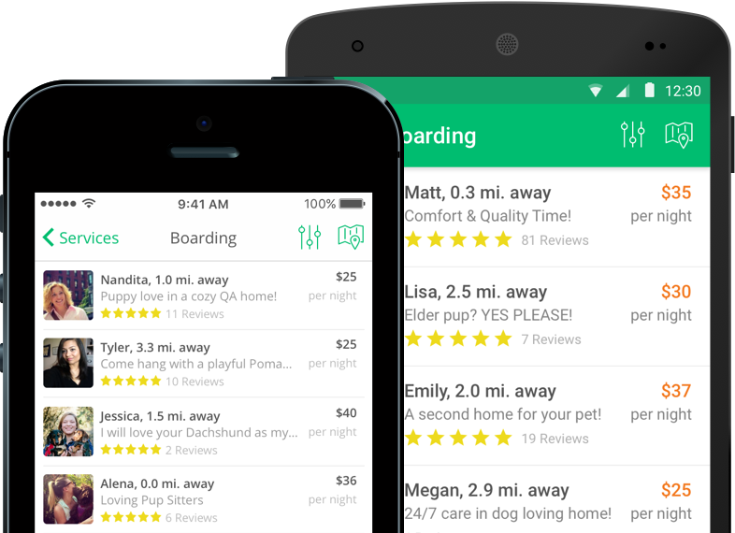

Steps to Quality Assuring
How can we select our sitters for the best service?
Step 2
Step 4
Advance checking are also available with address checks
An online course to teach sitters from how to create profiles to knowledge on pet care...
A rating system upon sitter’s profile out of 5 stars, and open review sections
Preliminary check
Rover 101
Quizing
Review and Rate
Step 1
Step 3
Background check for sitters profile to ensure safety
The quiz follows from the Rover 101 course, which requires a passing score of at least 88% to earn a Rover 101 badge.
A detailed sitter’s handbook is provided upon the blog
Provided via third party company ‘Checkr’ on your legal name, ID, social security no.
Notes:
Rover 101 and Quiz:
From : https://www.rover.com/rover-101/

Slide 19




Trust & Guarantee
How does Rover provide Trust and Safety?
Structured & Efficient Operation
Secured and cashless online payment
Schedule Meet and Greet before booking
⇒ Ensure Good Match & Security Between Sitters and Owners
Structured & Efficient Operation
High Credibility Sitters
Rover Guarantee
Automatically enrolled to ‘guarantee’ contract
⇒ Covers vetcare services and physical damage liability
⇒ A limit of up to $1 million compensation per accident
Rover acts as middleman when responsibility or liability arise to build confidence within consumers
Rover Guarantee
Excellent Support Team

Slide 20

Trust & Guarantee
How does Rover provide Trust and Safety?
High Credibility Sitters
Structured & Efficient Operation
Background check and monitored screening
⇒ Only 20% applicants passed the screening for walkers
On-going training and review system
High Credibility Sitters
Excellent Support Team
24/7 Trust and Safety Team Hotline
Provide help from vet professionals
⇒ To give a sense of security in case of emergency
Rover Guarantee
Excellent Support Team
Notes:
*Manual Search of County Records A manual search of county court records based on the person's address history over the last seven years.
(“Sitter and Dog Walker Background Checks.”Rover.com, www.rover.com/background-checks/.)
**Only 1% applicants passed the walker screening ‘Rover says about 1 percent of people who apply to be on-demand dog walkers make the cut.’
(Zaleski, and Bloomberg. “Wag, the 'Uber for Dog-Walking,' Is Drawing Scrutiny for Allegedly Losing Dogs.” SFGate, Bloomberg, 17 Oct. 2017, www.sfgate.com/business/article/Wag-the-Uber-for-Dog-Walking-Is-Drawing-12280890.php.)

Slide 21
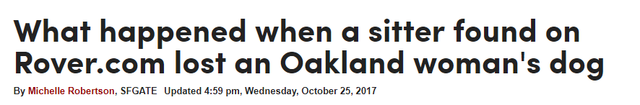
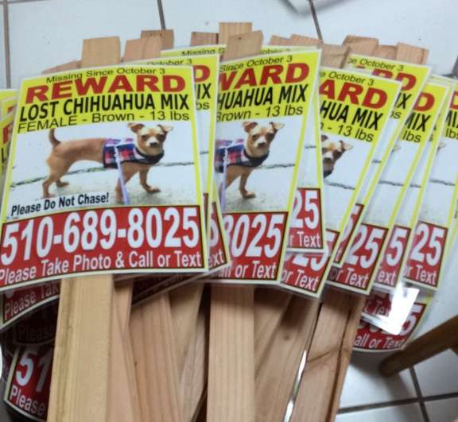

Case Study - Owner’s dog got missing
What have Rover actually done?
What Actually happens….
Employed 24/7 Trust and Service team
Conduct a full scale investigation and suspends the account of the sitter
1
Conducted a search by hiring local pet sitters of $40 per day, and cooperating to post alerts and flyer materials
2
Remained daily contact with the owner for 10 days Offered extra funding into printing flyers and donations for the owner
3
“
”
Rover is not liable for "for damages associated with Pet Care Services (which may include bodily injury to, or death of, a pet)" nor the costs associated therein.
THE OWNER’S DOG STILL NOT FOUND
THE OWNER TURNED TO MEDIA FOR ATTENTION UPON THE HIRING PROCESS OF ROVER
From the terms and services
Notes:
Full passage of news:
(Robertson, Michelle. “What Happened When a Sitter Found on Rover.com Lost an Oakland Woman's Dog.” SFGate, San Francisco Chronicle, 25 Oct. 2017, www.sfgate.com/bayarea/article/Rover-Uber-for-pets-lost-dog-12300456.php#photo-14407021.)
Rover Terms and Services
(“Terms of Service.” Rover.com, www.rover.com/tos/.)

Slide 22


Problems Behind the Deviation of Expectation
What actually happens...
We have qualified & credible sitters who went through our background checks!
Your background check only include criminal record but not action towards animals!
We assured the quality of our service!
Your ‘qualified’ sitters lost my dog!
We will protect you from uncertainty with Rover Guarantee!
The Guarantee does not cover my loss!
We have 24/7 support team to provide help in case of emergency!
Your 24/7 support team could only offer consolation with limited actual help during crisis!

Slide 23
The main problems outlined in the case
Insoluble Trust Issues & Unstandardized Service
Problems with Background Check → Inaccurate details provided
Only included criminal records with excluded violence behavior to animals sometimes
Problems with Rover Guarantee → Limited assurance
Binded guarantee with lots of terms and condition (E.g. Not cover any incidents involving automobiles* )
Little incentives to implement a more comprehensive Guarantee policy or even insurance
Lack of Controlling Power → Non-standardized services
Without power to ensure the sitters to follow the procedures set
Principal - Agent problems (Sitters may simply act on his benefits)
Customers’ doubt in Rover (Do not know the quality of services provided)
Notes:
*Q&A on Rover Guarantee: “Are there other conditions, exclusions, or limitations?
Yes. For example, injuries or damage involving automobiles or other vehicles, injury or damage caused by natural disasters or other uncontrollable events, or damage to precious goods such as fine art or family heirlooms, are excluded. For a complete understanding of the Rover Guarantee, including the full list of conditions, exclusions and limitations, we strongly encourage you to read the Rover Guarantee Terms and Conditions, which are part and parcel of Rover's Terms of Service.” (“Rover Guarantee.” Rover.com, www.rover.com/guarantee/.)
*Doubt shown on Rover forum:
‘’Rover actually has no way to confirm the accuracy of what we as sitters say about ourselves during the "application process" (i.e., what we say in our profiles and the questions we answer). And those of us who have opted for a background check have only proved that we haven't been caught doing anything criminal, and that we live where we say we do ... it's pretty basic info.’’
(“Rover.com.” How Do I Know I Can Trust... | Rover Q&A Community, www.rover.com/community/question/1192/how-do-i-know-i-can-trust-these-sitters-and-how-do-i-know-they-will-take-care-of-my-furbabies/.)

Slide 24




Recommendation: To prevent more of the same cases
Enhancement of Quality of Pet Sitters
Cooperate with Pet Sitters International (PSI)
CPPS-Certified Professional Pet Sitter® Exam
Demonstrate the knowledge and skills necessary to succeed and prosper as professional pet sitters
Benefit
Enhance the reliability of pet-sitters and confidence of the owners
Solve the problem of ineffective screening
Attract more people to use
Cost
Handling expenditure with PSI
Loss of sitters who can not pass the exam or would not take the exam due to the exam cost
⇒ Subsidize the 50,000 sitters with $200 (Exam Fee $275) to attract more people to take the exam
⇒ Can be recovered within short period of time
International Expansion
Enhancement of Quality of Pet Sitters
Service Expansion: Friends-making
Notes:
“Certification for Professional Pet Sitters.” Pet Sitters International, www.petsit.com/certification.
The application fee for the CPPS Exam is $275.

Slide 25
Recommendation: Opportunities to expand
Internationalization
Global Strategic Choice
- International Strategy
Serving universal needs
Little localization needed
Centralize service development with low cost
Acquire local firms to gain local knowhow and prevent fierce competition
Location Choice - China and Brazil
Highest no. of dogs and cats after US*
Emerging market of pet care sales**
Uncompetitive local firms Brazil: DogHero (Founded in 2014, 1,000+ sitters) China: 小狗在家 (Founded in 2015, 10,000+ sitters)
International Expansion
Enhancement of Quality of Pet Sitters
Service Expansion: Friends-making
Cost
Localization cost (Language, payment method, marketing)
Administration expenses for tackling the expansion
Notes:
*According to World Pet Population Data, Highest number of dogs and cats: USA (143,988,000), China (80,500,000), Brazil (48,266,000)
Dale, Steve. “World Pet Population Data Varies - but Human-Animal Bond Is Key.” Steve Dale Pet World, 13 June 2016, stevedalepetworld.com/world-pet-population-data-mixed-bag/.
**Global Spending on Pets
Euromonitor International calculates that global pet care sales topped $109 billion last year and will continue to grow through 2022, albeit modestly in established markets like the United States, but more rapidly in the emerging markets that include Brazil, India, China, and Mexico.
Durkin, Andrea. “Unleashing Global Spending on Pets.” TradeVistas, 16 Feb. 2018, tradevistas.csis.org/unleashing-global-spending-pets/.
Competitiveness in Brazil and China Brazil: DogHero (Founded in 2014, Only 1,000+ sitters)
China: 小狗在家 (Founded in 2015, Only 10,000+ sitters)
孙园 . “共享经济模式的宠物看护平台DogHero完成310万美元融资.” 亿欧首页, 30 Aug. 2016, m.iyiou.com/p/31122.

Slide 26
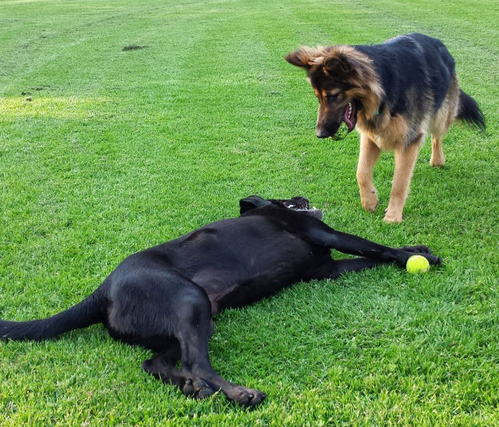
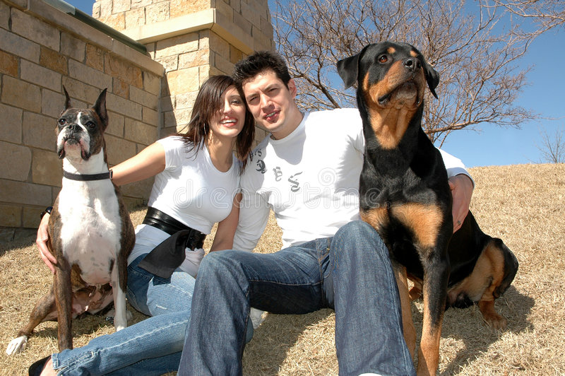
Recommendation: Opportunities to expand
Service Expansion: Friends-making
Value Creation
For Pets
Social animals need friends (eg. dogs, cats)
Enjoy being around others
Play with other pets to have joy
Exhibit improvement in their behavior once another pet is introduced
For Owners
Pal with someone who loves dogs
Expand the social network
International Expansion
Enhancement of Quality of Pet Sitters
Service Expansion: Friends-making
Notes:
Harleigh, Sharon. “How to Tell If a Dog Needs a Companion.” Pets, 14 July 2016, pets.thenest.com/tell-dog-needs-companion-5329.html.

Slide 27
Recommendation: Opportunities to expand
Service Expansion: Friends-making
Comparison
Limitation of Competitors
Competitive Advantage of Rover
International Expansion
Enhancement of Quality of Pet Sitters
Twindog/ Meet My Dog (Apps)
Without wide selection of options (less than 100, 000)
FETCH A DATE (Website)
Focus on owner-dating instead of pets
Rover (Apps and Website)
Relatively large customer base (>500,000)
Cover 10,000+ cities
Focus on pets more than owners
Service Expansion: Friends-making
Notes:
Editors, AskMen. “Yes, It's A Dating Site For Dog Owners - Get Ready To Swipe Ruff!” AskMen, www.askmen.com/dating/online-dating-sites/apps/twindog-review.html.
“Fetch A Date.” Fetch A Date, fetchadate.com/.
“A Fresh Breed of Social App for You and Your Dog.” Meet My Dog, meetmydogapp.com/.

Slide 28
Recommendation: Opportunities to expand
Service Expansion: Friends-making
Benefits to Rover
Related Diversification
International Expansion
Leverage the core competences (network, matching technology) to create new business without significant development cost
Enhancement of Quality of Pet Sitters
Synergy Effect
Increase the customers base
More uses on core businesses (pet-sitting, pet-boarding)
Networking Effect
Become more valuable for customers as more people use
Service Expansion: Friends-making
Cost to Rover
Research and Development Cost
Marketing Cost
Notes:
Hill, Charles W.L., Schilling, M.A., and Gareth R. Jones, Strategic Management Theory: An Integrated Approach, 12th ed., Cengage Learning, 2017.

Slide 29
Thank You!

Slide 30
Works Cited (MLA)
“About The Dog People.” Rover.com, www.rover.com/about-us/.
Albert-Deitch, Cameron. “This Founder Turned Doggy Daycare Into a $300 Million Business.” Inc.com, Inc., 25 Apr. 2017, www.inc.com/cameron-albert-deitch/30-under-30-2017-rover-com.html.“A Fresh Breed of Social App for You and Your Dog.” Meet My Dog, meetmydogapp.com/.
“A Pet App Can Be Your New Business Idea.” Code Brew Labs, 10 Apr. 2018, www.code-brew.com/2018/01/08/increasing-trend-pet-apps/.
“Book Dog Boarding, Dog Walking & More.” Rover.com, 2018, www.rover.com/?ref=header.
“Certification for Professional Pet Sitters.” Pet Sitters International, www.petsit.com/certification.
Coffee, Patrick. “Pereira O'Dell and Rover.com Will Walk Your Pooch in Style, Dawg.” AgencySpy, AgencySpy, 13 Apr. 2018, www.adweek.com/agencyspy/pereira-odell-and-rover-com-will-walk-your-pooch-in-style-dawg/145853.
Cook, John. “An Airbnb for Your Pet? A Place for Rover Wins Best in Show at Startup Weekend.” GeekWire, 27 Mar. 2014, www.geekwire.com/2011/airbnb-pet-introducing-place-rover/.
Dale, Steve. “World Pet Population Data Varies - but Human-Animal Bond Is Key.” Steve Dale Pet World, 13 June 2016, stevedalepetworld.com/world-pet-population-data-mixed-bag/.
Dassanayake, Dion. “Millions of Smartphone Apps Risk Sharing YOUR Personal Information.”Express.co.uk, Express.co.uk, 23 Apr. 2018, www.express.co.uk/life-style/science-technology/950080/Phone-warning-mobile-apps-Android-iOS-personal-data-risk.
Dave, Paresh. “Rover.com Acquires Santa Monica Dog-Sitting Start-up DogVacay, Which Couldn't Keep Up.” Los Angeles Times, Los Angeles Times, 29 Mar. 2017, www.latimes.com/business/technology/la-fi-tn-dogvacay-rover-20170329-story.html.
Durkin, Andrea. “Unleashing Global Spending on Pets.” TradeVistas, 16 Feb. 2018, tradevistas.csis.org/unleashing-global-spending-pets/.
“Dog Walking/Visit Rates.” Swifto | NYC Dog Walking with GPS Tracking, 6 Feb. 2018, swifto.com/pricing.
Editors, AskMen. “Yes, It's A Dating Site For Dog Owners - Get Ready To Swipe Ruff!” AskMen, www.askmen.com/dating/online-dating-sites/apps/twindog-review.html.
“Fetch A Date.” Fetch A Date, fetchadate.com/.
“Fetch! Pet Care, Servicing North Pittsburgh.” Fetch! Pet Care North Pittsburgh, www.fetchpetcare.com/pittsburgh-cranberry-wexford/services/#services.
Funderbeam. 2018, www.funderbeam.com/startups/rover-com/funding?ref=teleport.

Slide 31
Works Cited (MLA)
Griswold, Alison. “Dog-Sharing Is the New Hot Thing in the Sharing Economy.” Quartz, Quartz, 5 Apr. 2017, qz.com/950105/dog-sharing-is-the-new-hot-thing-in-the-sharing-economy/.
Harleigh, Sharon. “How to Tell If a Dog Needs a Companion.” Pets, 14 July 2016, pets.thenest.com/tell-dog-needs-companion-5329.html.
Hill, Charles W.L., Schilling, M.A., and Gareth R. Jones, Strategic Management Theory: An Integrated Approach, 12th ed., Cengage Learning, 2017.
“How to Start a Pet Sitting Business - License, Bonding, Insurance, Taxes, and More.” Surety1, surety1.com/guides/how-to-start-pet-sitting-business/.
Insurance, Healthy Paws Pet. “Healthy Paws Pet Insurance Joins Forces With Rover.com.”PR Newswire, PR Newswire Association, 1 Feb. 2018, www.prnewswire.com/news-releases/healthy-paws-pet-insurance-joins-forces-with-rovercom-300591646.html.
Jorgensen, Erica. “Rover.com Wins the 2014 GeekWire Startup of the Year Award!” Rover.com, 30 Sept. 2014, www.rover.com/blog/rover-wins-geekwire-startup-of-the-year-award/.
“Meet The Dog People: Announcing Rover's Exciting New Ad Campaign [Video].” Rover.com, 24 Apr. 2017, www.rover.com/blog/dog-people-campaign-rover-com/.
“Pet-Sitter Network Rover Got Its Paws on Millions More in VC Cash.” Fortune, fortune.com/2017/07/13/dog-walker-rover-startup/.
Pet Industry Market Size & Ownership Statistics, www.americanpetproducts.org/press_industrytrends.asp
“Privacy Policy.” Rover.com, Rover.com, 6 Apr. 2018, www.rover.com/privacy/?ref=footer.
“Rivals Rover, DogVacay Agree to Most Adorable Merger Ever.” PitchBook News, pitchbook.com/news/articles/rivals-rover-dogvacay-agree-to-most-adorable-merger-ever.
Robertson, Michelle. “What Happened When a Sitter Found on Rover.com Lost an Oakland Woman's Dog.” SFGate, San Francisco Chronicle, 25 Oct. 2017, www.sfgate.com/bayarea/article/Rover-Uber-for-pets-lost-dog-12300456.php#photo-14407021.
Roof, Katie, and Ryan Lawler. “Rover and DogVacay Merge to Dominate the Pet-Sitting Market.” TechCrunch, TechCrunch, 29 Mar. 2017, techcrunch.com/2017/03/29/rover-dogvacay-merge/.
“Rover.com CTO Works to Unleash Data-Driven Innovation.” SearchBusinessAnalytics, searchbusinessanalytics.techtarget.com/feature/Sharing-economy-CTO-works-to-unleash-data-driven-innovation.
“Rover.com-Funding.” Funderbeam, www.funderbeam.com/startups/rover-com/funding?ref=teleport.
“Rover Guarantee.” Rover.com, www.rover.com/guarantee/.
“Rover.com.” How Do I Know I Can Trust... | Rover Q&A Community, www.rover.com/community/question/1192/how-do-i-know-i-can-trust-these-sitters-and-how-do-i-know-they-will-take-care-of-my-furbabies/.

Slide 32
Works Cited (MLA)
Rysman, Marc. 2009. "The Economics of Two-Sided Markets." Journal of Economic Perspectives, 23 (3): 125-43
Schlosser, Kurt. “Rover Acquires DogVacay, Its Biggest Competitor in the Online Dog-Sitting Marketplace.” GeekWire, 30 Mar. 2017, www.geekwire.com/2017/rover-acquires-dogvacay-biggest-competitor-online-dog-sitting-marketplace/.
Sevits, Kurt. “Rover.com Expands on-Demand Dog Walking Service to Denver.” 7NEWS, 27 Sept. 2017, www.thedenverchannel.com/news/local-news/rovercom-expands-on-demand-dog-walking-service-to-denver.
“Sitter and Dog Walker Background Checks.”Rover.com, www.rover.com/background-checks/.
“Terms of Service.” Rover.com, www.rover.com/tos/.
Truzzi, Gianni. “The 2017 Executive Excellence Awards: Scott Porad.” Seattle Business Magazine, 2 Mar. 2017, seattlebusinessmag.com/profiles/2017-executive-excellence-awards-scott-porad.
“Tuesday, April 5, 2016 Zingy's On-Demand, Dog Walking Services Acquired By Rover.” Zingy's On-Demand, Dog Walking Services Acquired By Rover, www.socaltech.com/zingy_s_on_demand_dog_walking_services_acquired_by_rover/s-0064762.html.
Tumala, Carlo. “HOT DOG: THE $5 BILLION UBERESQUE DOG SITTING MARKET.” PetPace Smart Collar, 24 Mar. 2018, petpace.com/hot-dog-5-billion-uberesque-dog-sitting-market/.
“Unleashed: 70+ Companies Targeting The Pet Industry.” CB Insights Research, 6 July 2017, www.cbinsights.com/research/pet-tech-market-map/.
“What Are the Service Fees?” Help Center, support.rover.com/hc/en-us/articles/205385304-What-are-the-service-fees-.
孙园 . “共享经济模式的宠物看护平台DogHero完成310万美元融资.” 亿欧首页, 30 Aug. 2016, m.iyiou.com/p/31122.
Zaleski, and Bloomberg. “Wag, the 'Uber for Dog-Walking,' Is Drawing Scrutiny for Allegedly Losing Dogs.” SFGate, Bloomberg, 17 Oct. 2017, www.sfgate.com/business/article/Wag-the-Uber-for-Dog-Walking-Is-Drawing-12280890.php.
2017-2018 APPA National Pet Owners Survey, www.americanpetproducts.org/pubs_survey.asp.
“2017-2018 Pet-Sitting Industry Forecast.” Pet Sitters International, www.petsit.com/2017-2018-pet-sitting-industry-forecast.

Slide 33
List of Appendices
Funding and Investors
Top Rover Cities
Industry concentration analysis
Total U.S. Pet Industry Expenditures

Slide 34
Funding and Investors
Source: Funderbeam (https://www.funderbeam.com/startups/rover-com/funding?ref=teleport)
Amount | Date (Type) | Investors
USD 3.4M | Apr 2012 (Series A) | CrunchFund, Madrona Venture Group
USD 7M | Feb 2013 (Series B) | Foundry Group, Madrona Venture Group
USD 3.5M | July 2013 (Series B) | CrunchFund, Madrona Venture Group, Rolling Bay, Petco
USD 12M | Mar 2014 (Series C) | Foundry Group, Madrona Venture Group, Petco, Menlo Ventures
USD 25M | Mar 2015 (Series D) | Foundry Group, Madrona Venture Group, Petco, Menlo Ventures, Tcv
USD 40M | Oct 2016 (Series E) | Foundry Group, Madrona Venture Group, Menlo Ventures
USD 65M | Jul 2017 (Series F) | Bespoke Strategies, Foundry Group, Madrona Venture Group, Tcv, Menlo Ventures, OMERS Ventures, Spark Capital, StepStone Group
Notes:
Funderbeam. 2018, www.funderbeam.com/startups/rover-com/funding?ref=teleport.

Slide 35
II. Top Rover Cities
Source: Rover.com (https://www.rover.com/?ref=header)
Atlanta | Cleveland | Jacksonville | Minneapolis | Portland | Seattle
Austin | Columbus | Kansas City | Mississauga | Richmond | Tampa
Baltimore | Dallas | Las Vegas | New York City | Sacramento | Toronto
Boston | Denver | Lexington | Oakland | Saint Louis | Tucson
Calgary | Edmonton | Los Angeles | Orlando | Salt Lake City | Washington D.C.
Charlotte | Fort Worth | Madison | Ottawa | San Antonio | Winnipeg
Chicago | Houston | Miami | Philadelphia | San Diego
Cincinnati | Indianapolis | Milwaukee | Phoenix | San Jose

Slide 36
III. Industry concentration analysis
Company | Rover | Swifto | Wag! | Fetch! Pet Care
Sitters/Walkers | 140,000+ | Not available | Not available | 3,000+ *
Booking | $150M+ | 180000+ ** | Not available | Not available
Valuation | 866.67 B | Not available | Not available | Not available
Est. Revenue | 9.7M (Rover and DogVacay combined | Not available | <1M | 3M***
Notes:
Sourced from:
*https://www.fetchpetcare.com/media-fact-sheet/
**https://swifto.com/pricing
***https://www.owler.com/company/fetchpetcare

Slide 37
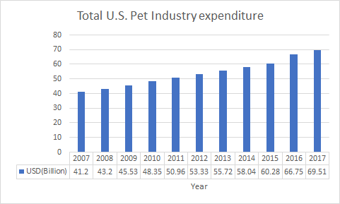
IV. Total U.S. Pet Industry Expenditures
Source: The American Pet Products Association (APPA) (http://www.americanpetproducts.org/press_industrytrends.asp)

